Slide 1




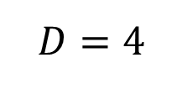
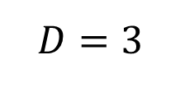
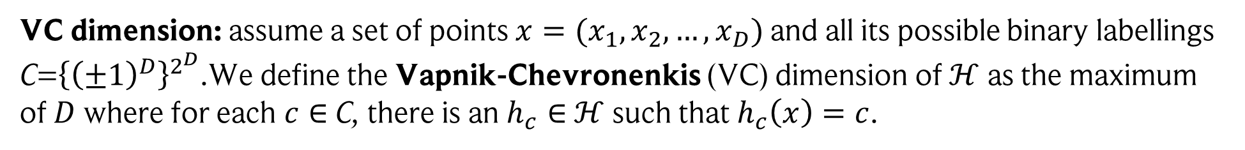




Appendix: VC dimension – a classic!
The VC dimension is also a way of measuring the complexity of $ℋ$, but for binary classification.
Assume we have a hypothesis set $ℋ$. We count the number of “equivalent” functions in $ℋ$ by estimating how many points can be separated by $ℋ at best.$
VC dimension: assume a set of points ${x=(x}_{1}, x_{2}, …,x_{D})$ and all its possible binary labellings C=${\left\{{\left(±1\right)}^{D}\right\}}^{2^{D}}$.We define the Vapnik-Chevronenkis (VC) dimension of $ℋ$ as the maximum
of $D$ where for each $c∈$ C, there is an $h_{c}∈$ $ℋ$ such that $h_{c}\left(x\right)=c$.
Note: we only have to find one set of points for which this is true!
Example: linear regression
$$D=3$$
$$D=4$$
$$y$$
$$y$$
$$y$$
$$y$$
etc.
$$x$$
$$x$$
$$x$$
$$x$$

Slide 2
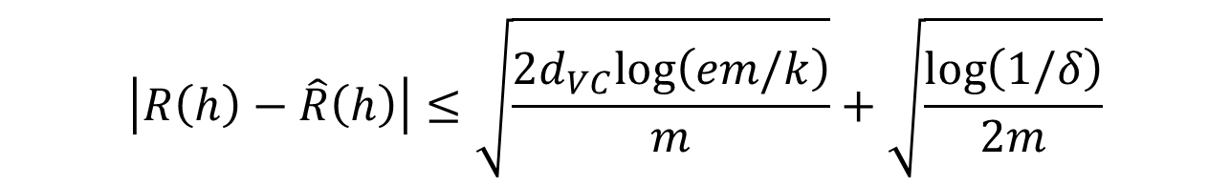

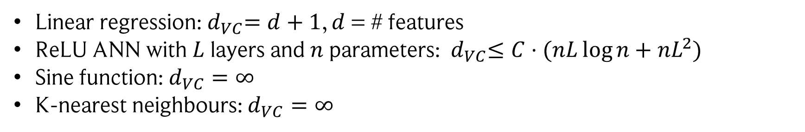
Learning bound: VC dimension
If $ℋ$ has VC dimension $d_{VC}$, we have with probability $1−δ$ for all $h∈ℋ$ and for $m≥$ $d_{VC}$:
$$\left|R\left(h\right)−\hat{R}\left(h\right)\right|≤\sqrt{\frac{2d_{VC}log\left(em/k\right)}{m}}+\sqrt{\frac{\log\left(1/δ\right)}{2m}}$$
Examples:
$C>0$, independent of $n$ and $L$
Linear regression:${ d}_{VC}=d+1$, $d$ = # features
ReLU ANN with $L$ layers and $n$ parameters: ${ d}_{VC}≤C⋅(nL\log{n+nL^{2})}$
Sine function:$d_{VC}=∞$
K-nearest neighbours: $d_{VC}=∞$

